Slide 1




$$k_{1}$$
$$k_{2}$$
C
H
A
$$λ_{1}$$
$$λ_{2}$$

Slide 2


















$$δ(1−φ)$$
$${ψk}_{1}C$$
$$k_{2}A$$
SC
SH
SA
$$δφ$$
$$λ_{1}$$
$$λ_{2}$$
$$βI$$
$$βρI$$
$${ψk}_{3}C$$
$$βI$$
IC
$$λ_{3}$$
IA
$$λ_{4}$$
γ
$$k_{4}A$$
γ
$${ψk}_{5}C$$
RC
$$λ_{5}$$
RA
$$δ$$
$$λ_{6}$$
$$k_{6}A$$

Slide 3
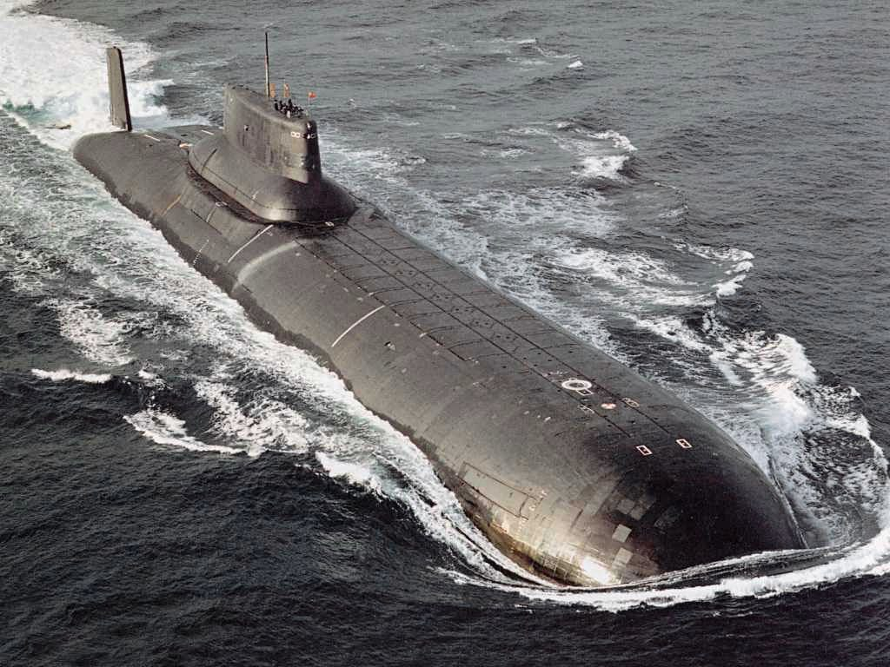
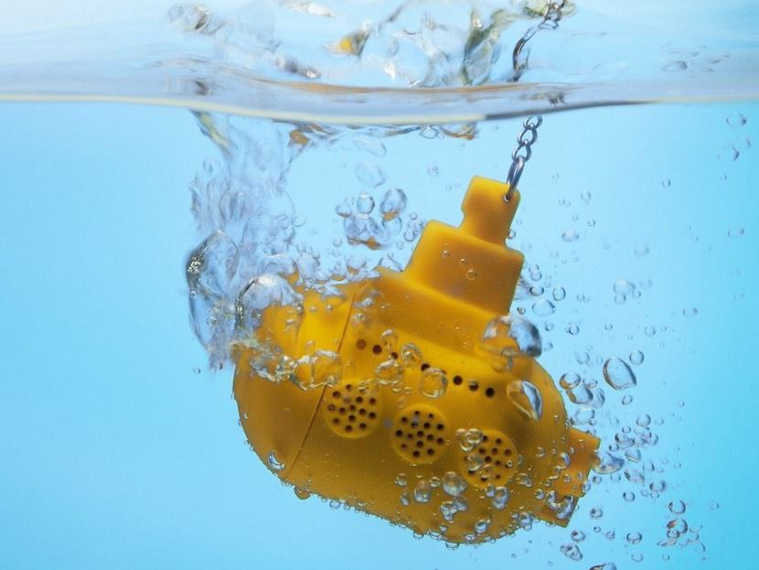
TESI:
ASPETTATIVE
REALTÀ

